Slide 1



Presentation for SKY Cast
THE USERS NAME AND SURNAME AND STUDENT NUMBER
TSHEPANG BANDA
ST10454008

Slide 2
The purpose of the App
The reason for the creation of my app is for people be able to see what the temperature of a specific day or to be able to see the temperature of the following day , it also allows the user to see the Average temperature of the week. So basically, the app can be used by anyone as it is very easy to use. I made use of bright colours as they can catch the people `s attention, the picture I also used as my symbol is very nice and it already says more about what the all is all about. The app can also be considered as an educational application as the people will be inputting minimum temperatures then there will be information about that specific day as that can improve the reading skills and understanding for young people.

Slide 3
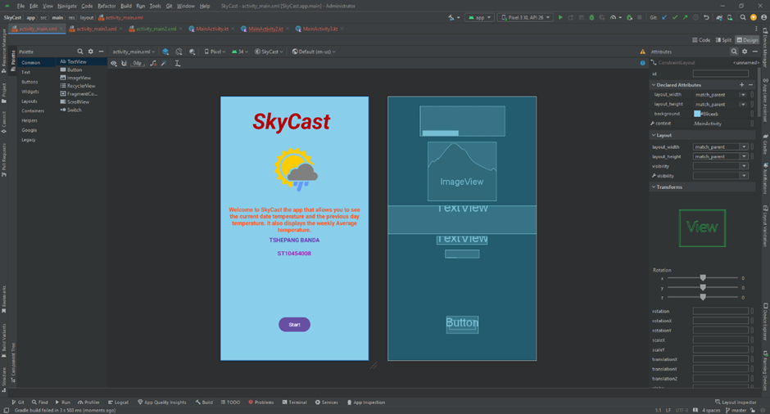
THE SCREENSHOT

